Slide 1

Ethical Hacking COSC 6840 Midterm Project
Andy Yothsackda, Alyssa Scott, Jon Menzel

Slide 2




Introduction
Client: Thanos LLC
Scope: A Comprehensive Firmware Security Assessment
Objectives: Identify Vulnerabilities & Develop Automated Exploitation Script
Deliverables: Provide a Vulnerability Report, Proof-of-Concept Script, & Presentation
Notes:
Client: ThanosTech LLC
Project Scope: A comprehensive firmware security assessment of ThanosTech LLC's router firmware, focusing on the latest generation of their flagship product line.
Key Objectives: To identify vulnerabilities, implement advanced security analysis techniques, and develop automated, repeatable testing protocols for ongoing security assurance.
Ultimate Goal: To significantly enhance product security, protect user data, and safeguard against potential cyber threats and reputational damage.
Final Deliverables: A detailed vulnerability report, a proof-of-concept demonstration script for critical findings, and a team presentation of findings and strategic recommendations for future development.

Slide 3

Methodology & Tools
Ubuntu
Visual Studio Code
Python
Binwalk
Noseyparker
Notes:
Python
Used for automation scripts and parsing extracted firmware data to identify indicators of vulnerability.
Visual Studio Code
Development environment for Python scripting and code review of extracted binaries or configuration files.
Binwalk
Extracted embedded file systems and firmware components for static analysis.
File
Determined file types (ELF binaries, compressed archives, etc.) to guide further analysis steps.
Strings / grep
Searched firmware contents for readable text, credentials, URLs, or hardcoded keys.
Hexdump
Performed low level inspection of binary data to identify hidden or encoded information.

Slide 4
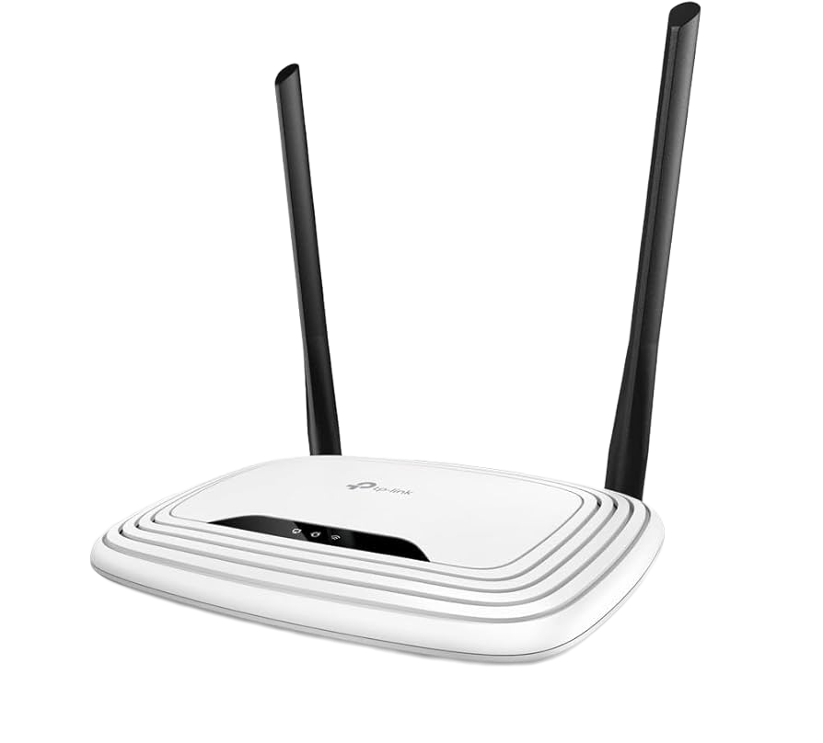
Vulnerability Findings Pt.1
Product: TP-Link TL-WR841N
Vulnerability: Dropbearpwd Improper Authentication Information Disclosure
Announced Date: May 2, 2024
Dropbearpwd vulnerability (CVE-2023-50224) affects TP-Link TL-WR841N routers, allowing network-adjacent attackers to disclose sensitive information without authentication. (https://nvd.nist.gov/vuln/detail/cve-2023-50224)
The flaw in the httpd service (TCP port 80) stems from improper authentication, enabling attackers to retrieve stored credentials from /tmp/dropbear/dropbearpwd and bypass HTTP Basic authentication. (https://www.tp-link.com/us/support/faq/4365/)

Slide 5

Vulnerability Findings Pt. 2
Product: D-Link DCS-8000LH
Initial Analysis Date by NIST: February 13th, 2019
Vulnerabilities
D-Link DCS series Wi-Fi cameras expose sensitive device configuration information.
This affects many DCS series models with firmware versions 1.00 and above.
The configuration file is remotely accessible without authentication at <Camera-IP>/common/info.cgi.
The file includes details like model, MAC address, IP address, and various device settings.
https://nvd.nist.gov/vuln/detail/cve-2018-18441#:~:text=Description,cgi%2C%20with%20no%20authentication

Slide 6


Automation Script & Recommendations
Github: https://github.com/jmenz-93/team-ftw-fw
Immediate Remediation (Critical Security Updates)
Remove Hardcoded Secrets
Disable Insecure Management Interfaces
Update Core Components
Verify Firmware Integrity
Long Term Hardening (Configuration & Access Control)
Remove Default Credentials
Limit System Privileges
Remove Debug Artifacts
Restrict Network Exposure
Priority Focus:
Remove embedded credentials, disable Telnet/plaintext services, rotate exposed keys; Component updates.
Notes:
Immediate Remediation (Critical Security Updates)
• Remove Hardcoded Secrets – Revoke AWS keys, GitHub tokens, private keys; use secure storage; integrate Nosey Parker in CI/CD.
• Disable Insecure Management Interfaces – Remove Telnet/HTTP; enforce SSH/HTTPS; key-based authentication and first-login reset.
• Update Core Components – Upgrade BusyBox/OpenSSL; maintain SBOM for version and CVE tracking.
• Verify Firmware Integrity – Use cryptographic signing and secure boot to block tampered firmware.
Long-Term Hardening (Configuration & Access Control)
• Remove Default Credentials – Force unique admin credentials on setup.
• Limit System Privileges – Run services with minimal permissions.
• Remove Debug Artifacts – Exclude dev scripts/logs from production.
• Restrict Network Exposure – Disable unused ports; enforce rate limiting.
Priority Focus: Remove embedded credentials, disable Telnet/plaintext services, rotate exposed keys; follow with component updates and secure boot integration

Slide 7


